Slide 1
DSO Project 2 - Phase 4
By Amanda Cashman, Jou An Lin, Kayla Yedidsion, Selena Sun, Brynne Di Donato, Wei Chien Chang, Meg Gupta, Josh Sherman

Slide 2
Phase 3 Summary
Business Goal: Our business goal is to analyze the relationship between gross revenue and several other factors such as yearly unemployment rate, rating, genre, year, country, and more.
Dependent Variables: Gross Revenue (numeric variable)
Independent Variables:
Numerical Variables: Budget, Runtime, Unemployment Rate, Employment Rate, IMDB Score, Year
Categorical Variables: Genre, Country, Movie Rating
Calculated Variables: Unemployment Rate, Employment Rate
Data Source 1: Movie Industry Analysis - access data set
File 1 (Movie Data): 7,668 rows
Data Source 2: US Employment & Unemployment Rate since 1940 - access data set

Slide 3
Phase 3 Summary Continued
Correlations: Each variable has a statistically significant relationship with gross revenue (p < .05) → Budget has the strongest correlation (shown in the scatter plot)
Analysis:
We had a reasonably strong goodness of fit & a weak R-Square of 0.1003, which indicates our model explains only 10.03% of the total variance
The correlations show that all of the independent numerical variables are related to the dependent variable, gross revenue.
Only “score” and “budget” can be used to predict “gross.” It’s a high-valued model which can explain almost half of our data.
The result of ANOVA indicates long movies (movies that last longer than 90 minutes) make higher revenue, and people also prefer watching animation movies over other genres. Thus, long animation movies are the most profitable. However, this result can only explain 10% of the data according to the weak R square.
Overall, our ANOVA model is statistically significant with a p value <0.0001

Slide 4
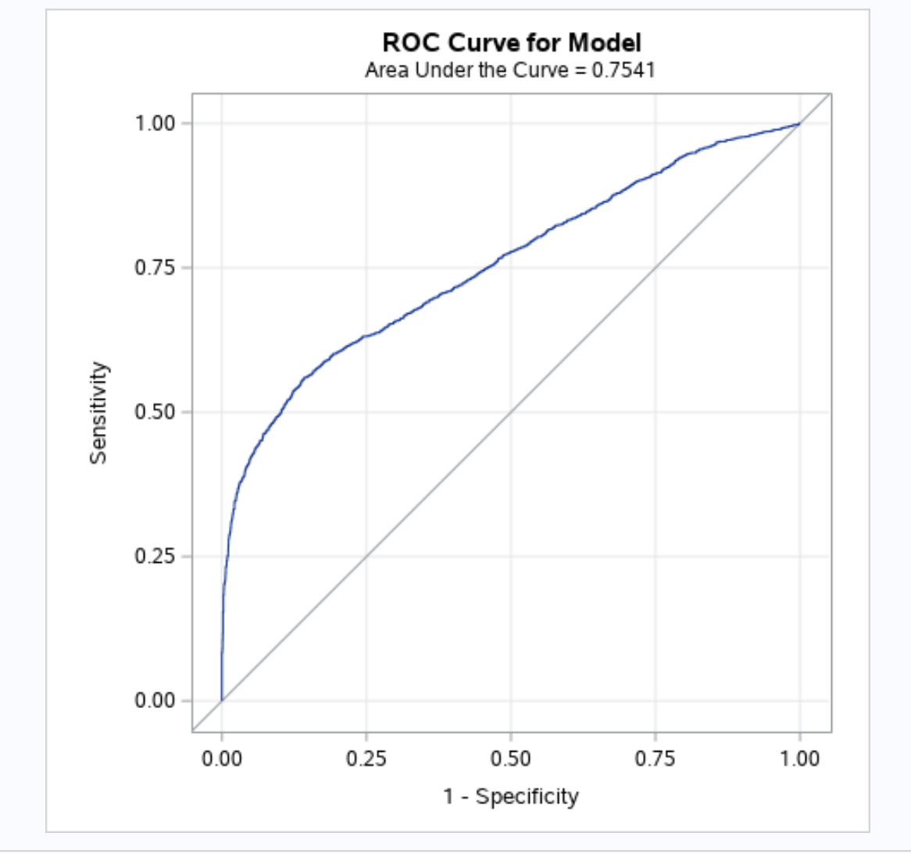
ROC Curve
75% goodness of fit
0.75 is high for the area under the curve (close to 1)

Slide 5
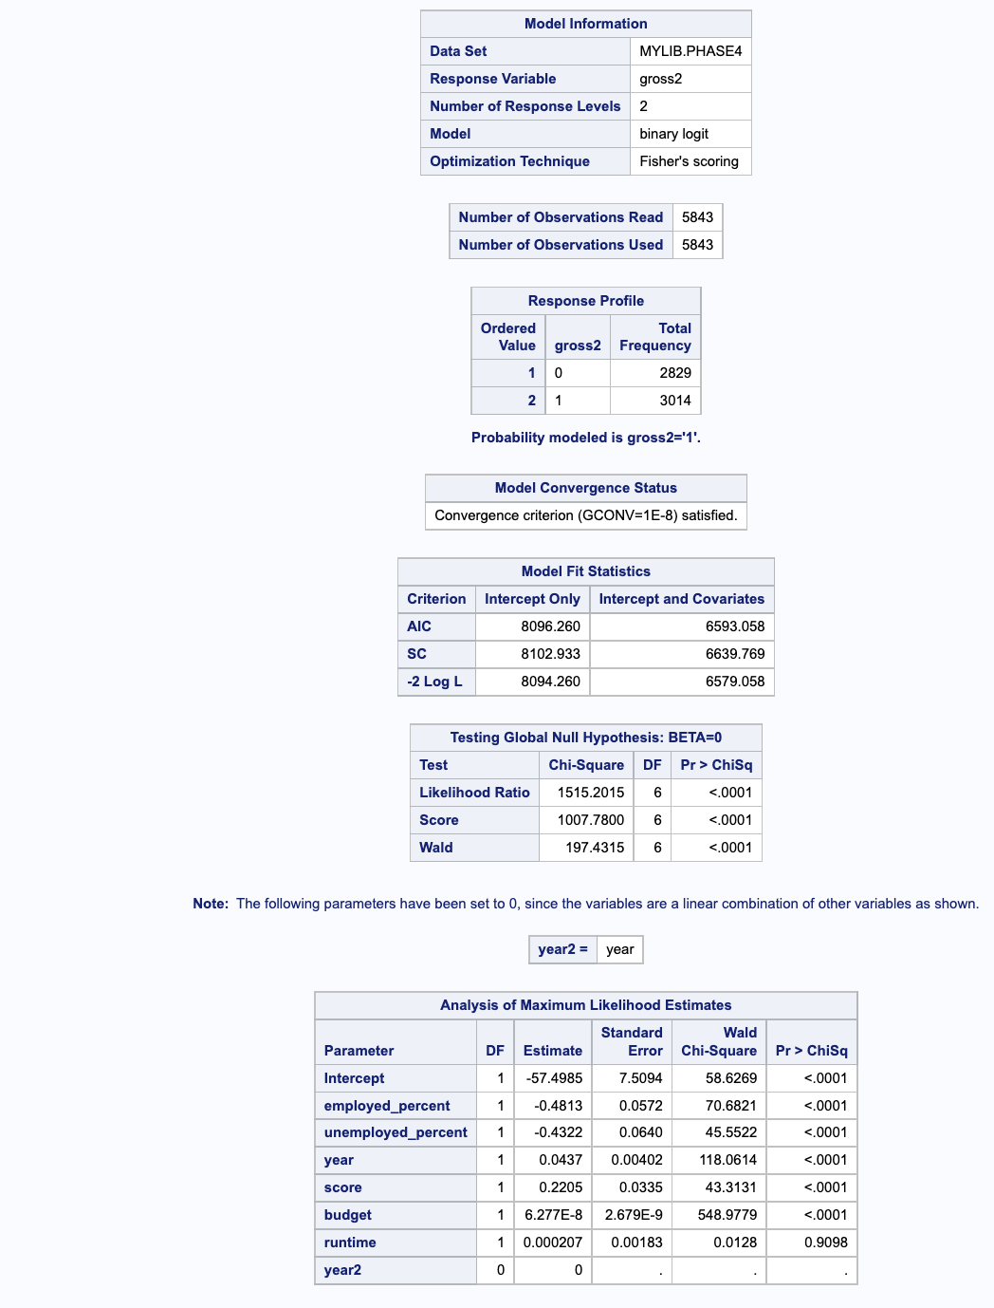
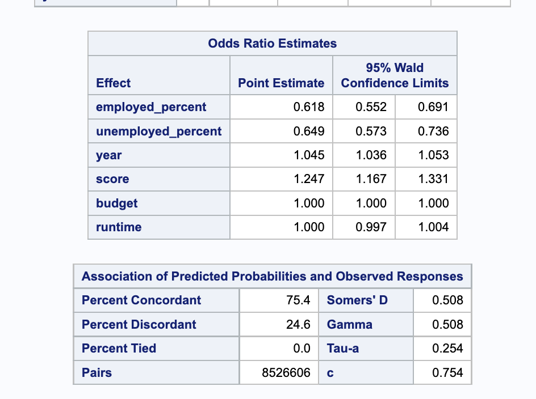
Binary Logistic Regression Tables

Slide 6
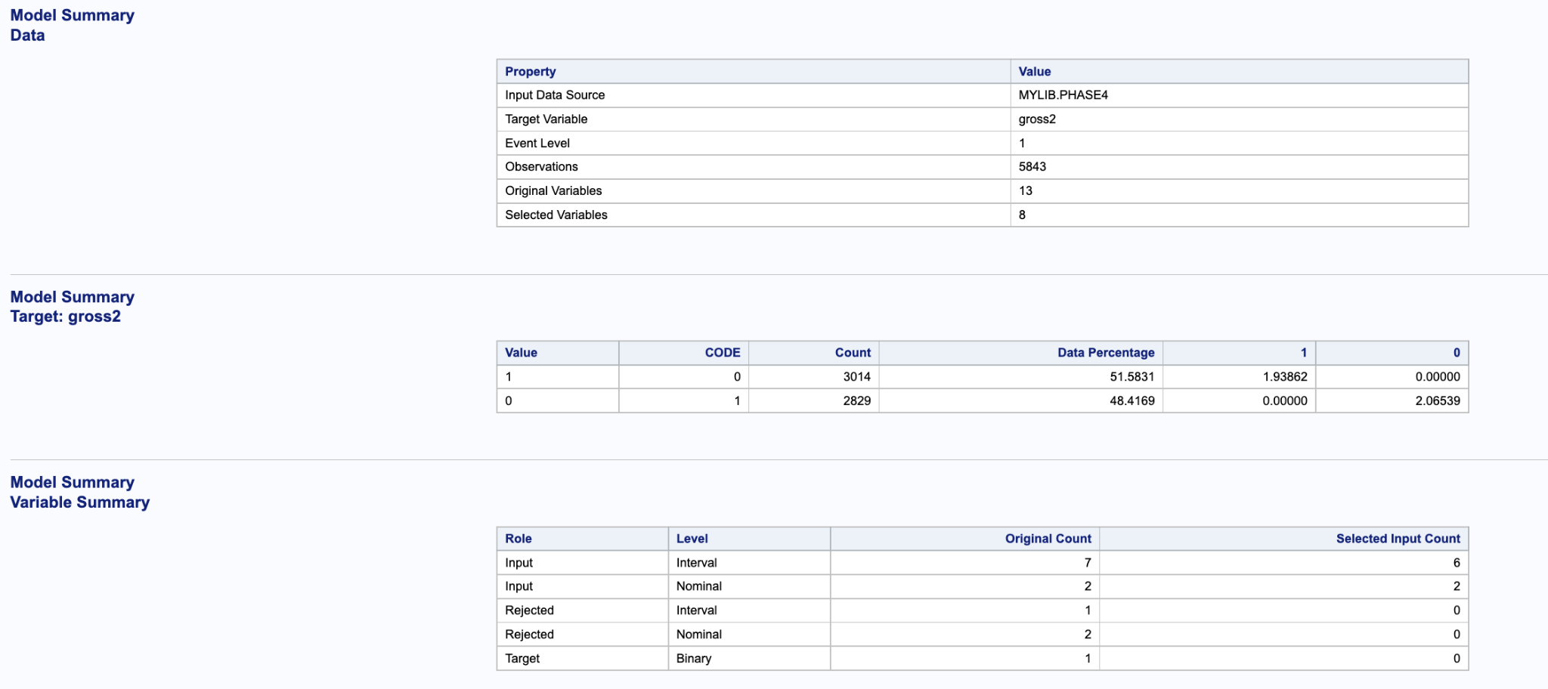
SAS Rapid Predictive Modeler (RPM) Results
Target Variable: gross2, which is gross revenue divided into “high” or “low” depending on whether it was higher or lower than the median gross revenue
Selected Variables: budget, year, unemployed_percent, employed_percent, rating, runtime, genre and score

Slide 7
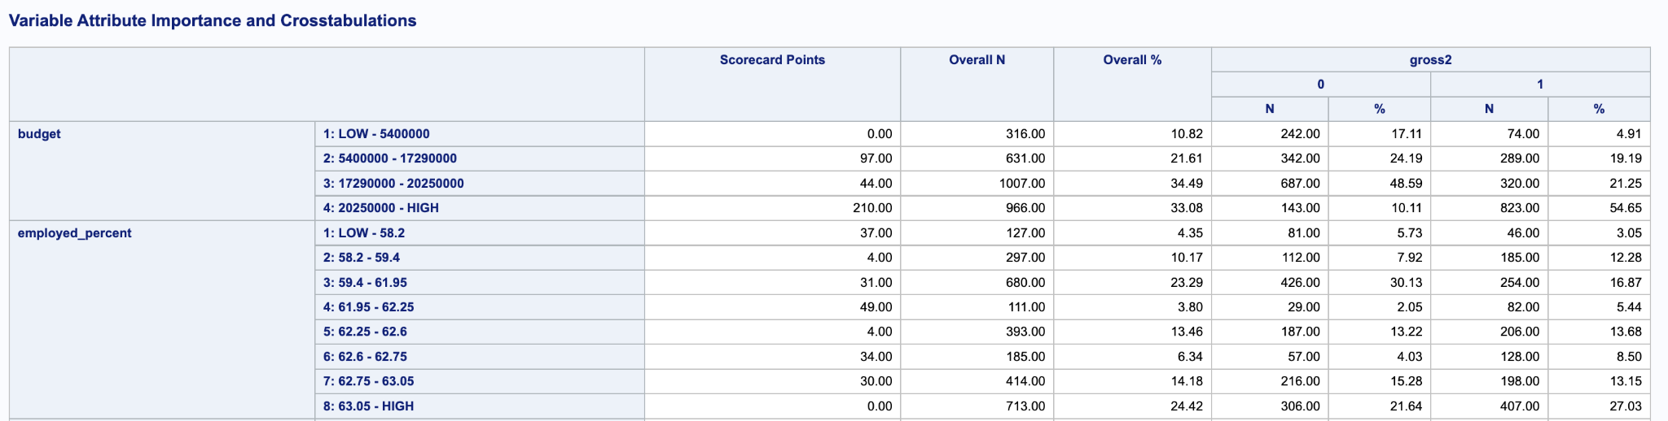
Variable Attribute Importance and Crosstabulations
The high budget bucket has the highest concentration of high gross profit movies (54.65%)

Slide 8
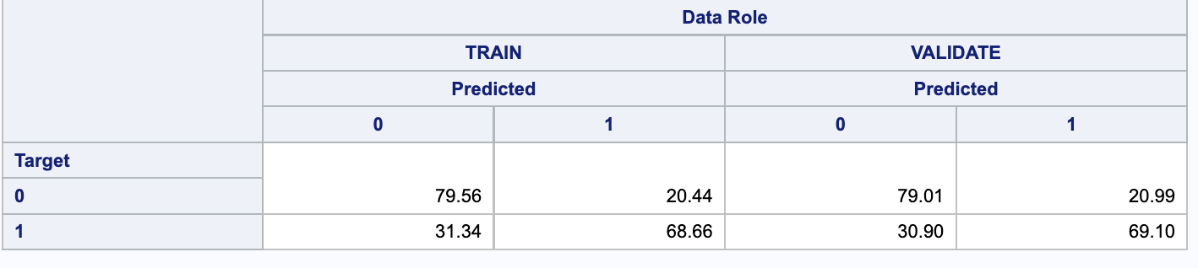
Classification Matrix Target
The sensitivity of the model is 68.66%, and it can also predict 69.1% of data that hasn’t been seen before.
The specificity of the model is around 79% for both the train model and data that hasn't been seen before.

Slide 9
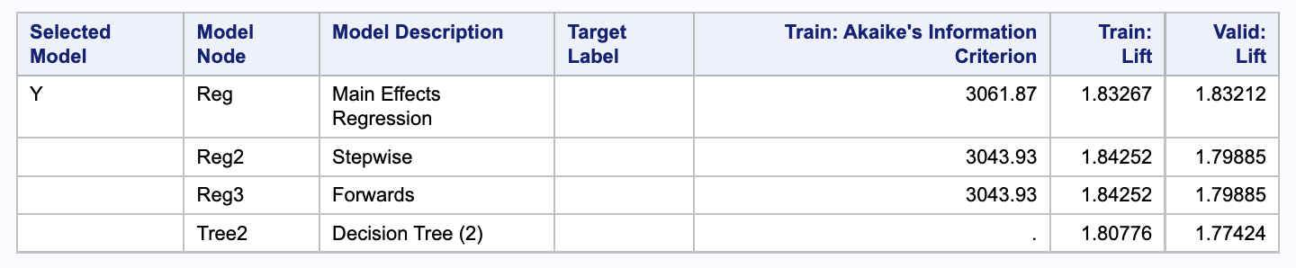
Choice of Model
SAS chose to use the Main Effects Regression method as the model for this analysis
Highest Akaike’s Information Criterion
Notes:
Josh

Slide 10
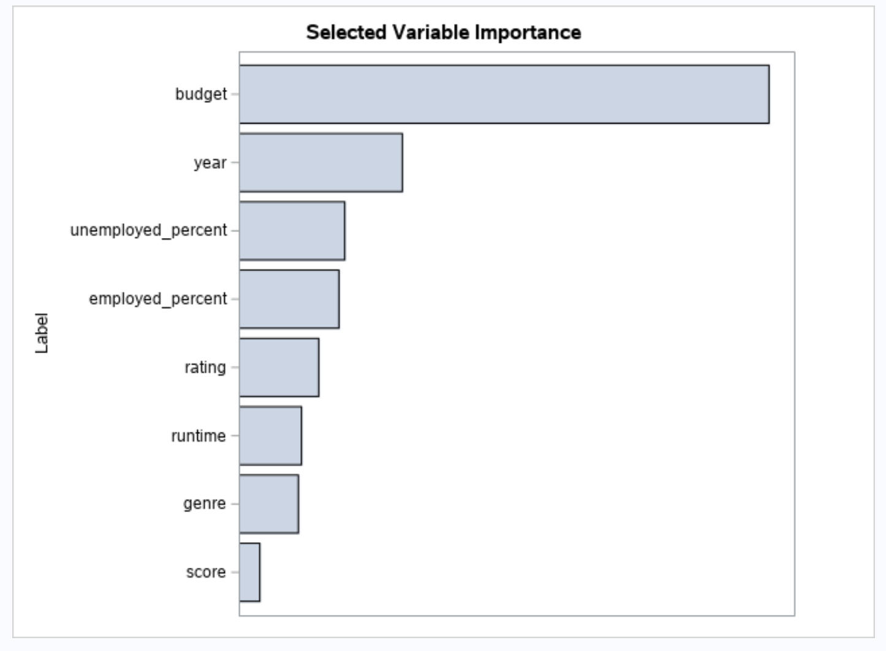
Selected Variable Importance
Budget has the most impact on the dependent variable (gross revenue) by a significant margin
Year has the second most importance followed by unemployed percent and employed percent
The latter two variables reflect the current state of the U.S. economy and therefore how much money people have to spend on movies
Score is the least important variable

Slide 11
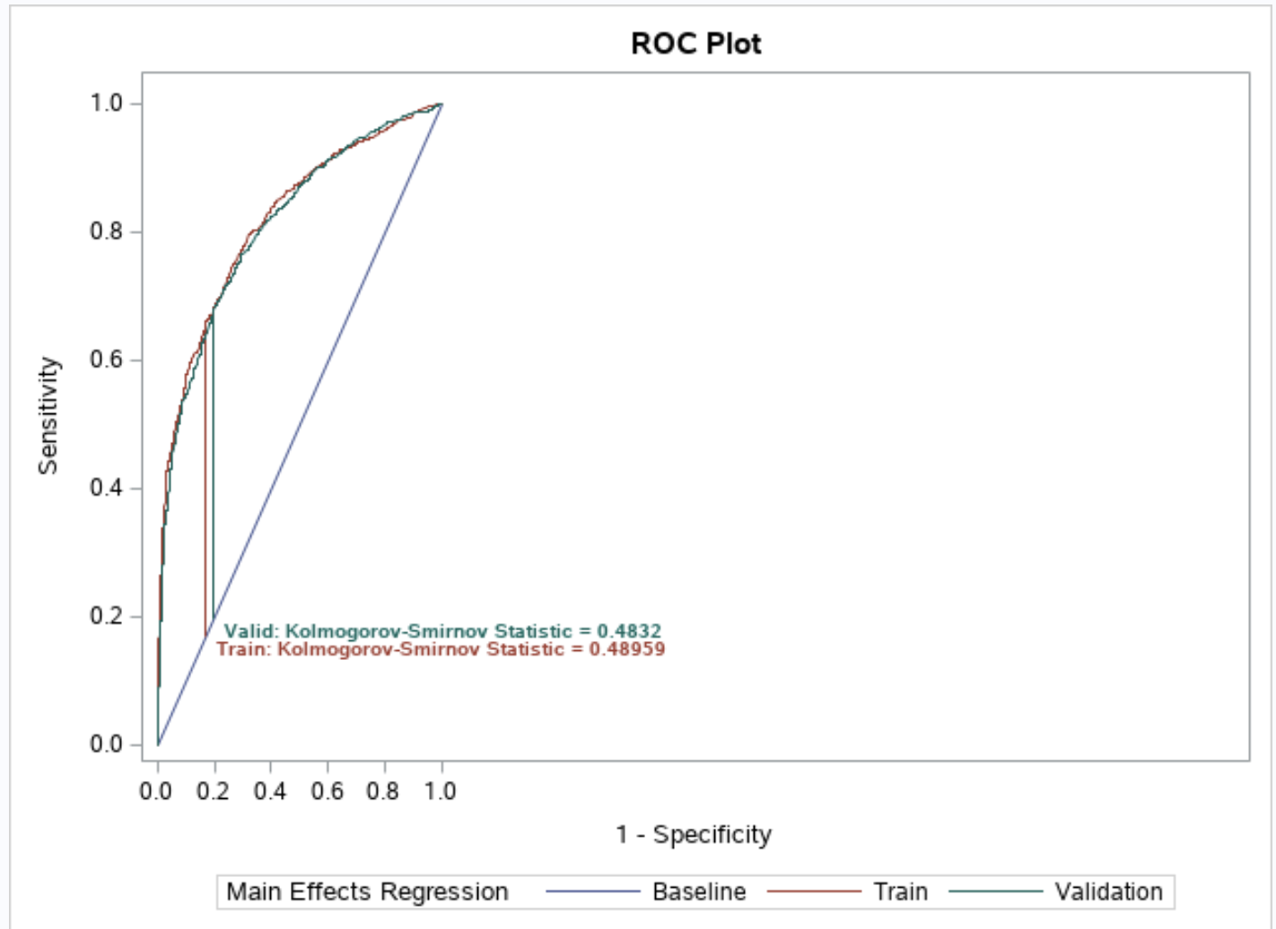
Roc Plot Comparison
The Binary Logistic Regression model (shown on the left) explains the variance more accurately than the Rapid Predictive Modeler (shown on the right)
It demonstrates that our model has a high amount of sensitivity, and so a high amount of accuracy in predicting results. There was also a low rate of specificity which demonstrates a low number of false positive results.
Notes:
Meg

Slide 12
Conclusion
We have high goodness of fit to model: Our ROC curve for model is marked at 0.7541
Budget and Year are the top two most impacted dependent variables
The high budget bucket has the highest concentration of high gross profit movies (54.65%)
To aim for the highest gross revenue, providing the highest budget is the statistically proven way which has the highest chance of achieving the goal

Slide 13
DSO Project 2 - Phase 3
By Amanda Cashman, Jou An Lin, Kayla Yedidsion, Yuzi Sun, Brynne Di Donato, Wei Chien Chang, Meg Gupta, Josh Sherman

Slide 14
Phase 1 & 2 Summary
Business Goal: Our business goal is to analyze the relationship between gross revenue and several other factors such as yearly unemployment rate, rating, genre, year, country, and more.
Dependent Variables: Gross Revenue (numeric variable)
Independent Variables:
Numerical Variables: Budget, Runtime, Unemployment Rate, Employment Rate, IMDB Score
Categorical Variables: Year, Genre, Country, Movie Rating
Calculated Variables: Unemployment Rate, Employment Rate
Data Source 1: Movie Industry Analysis - access data set
File 1 (Movie Data): 7,668 rows
Data Source 2: US Employment & Unemployment Rate since 1940 - access data set

Slide 15
Phase 1 & 2 Summary Cont.
Number of Observations:
File 1 (Movie Data): 7,668 rows
File 2 (Employment Data): 71 rows
Files: 2 files, inner join (common variable: year of movie release)
Correlations: Each variable has a statistically significant relationship with gross revenue (p < .05) - budget has the strongest correlation
Analysis:
Positive correlation between employment rate and mean gross revenue - better economics conditions lead to more revenue success for films
Family-friendly movies had higher mean gross revenue compared to niche genres and movies with limited age ranges

Slide 16
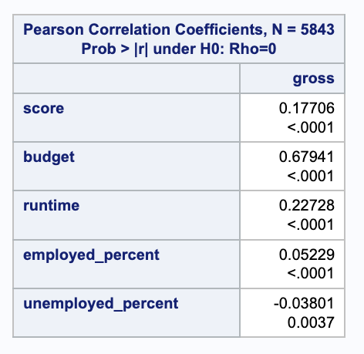
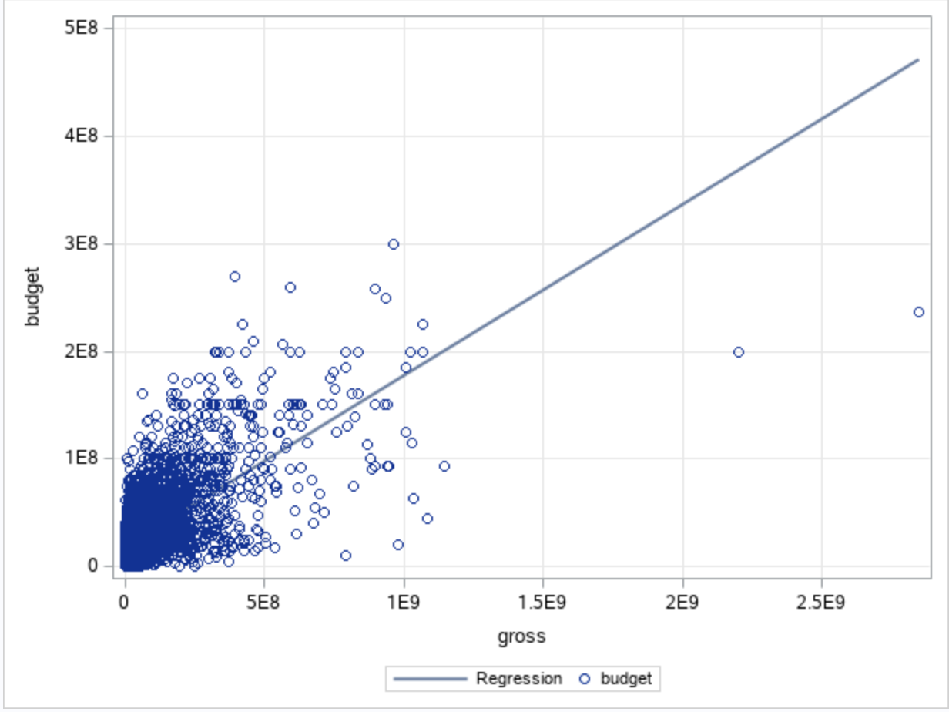
Phase 3 - Correlations
Each variable has a statistically significant relationship with gross revenue (p < .05)
Budget has the strongest correlation (shown in the scatter plot)
Notes:
Jou ann

Slide 17
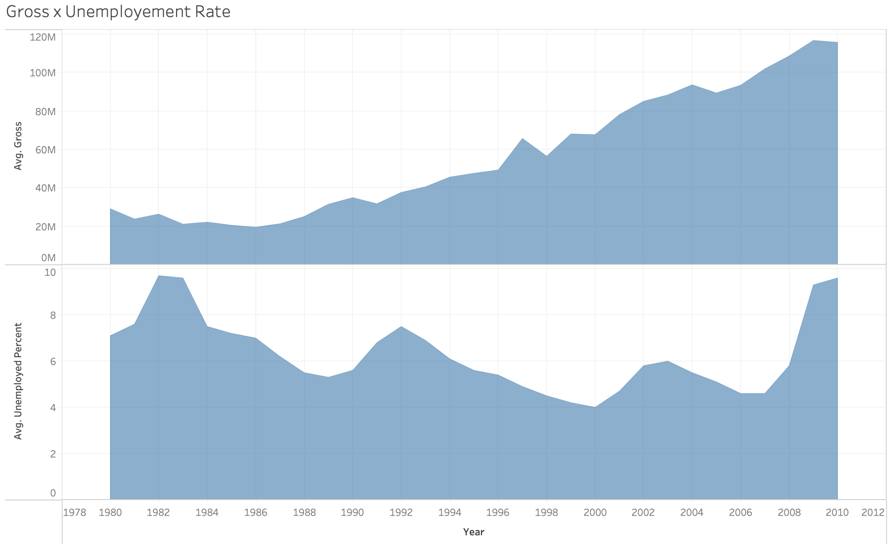
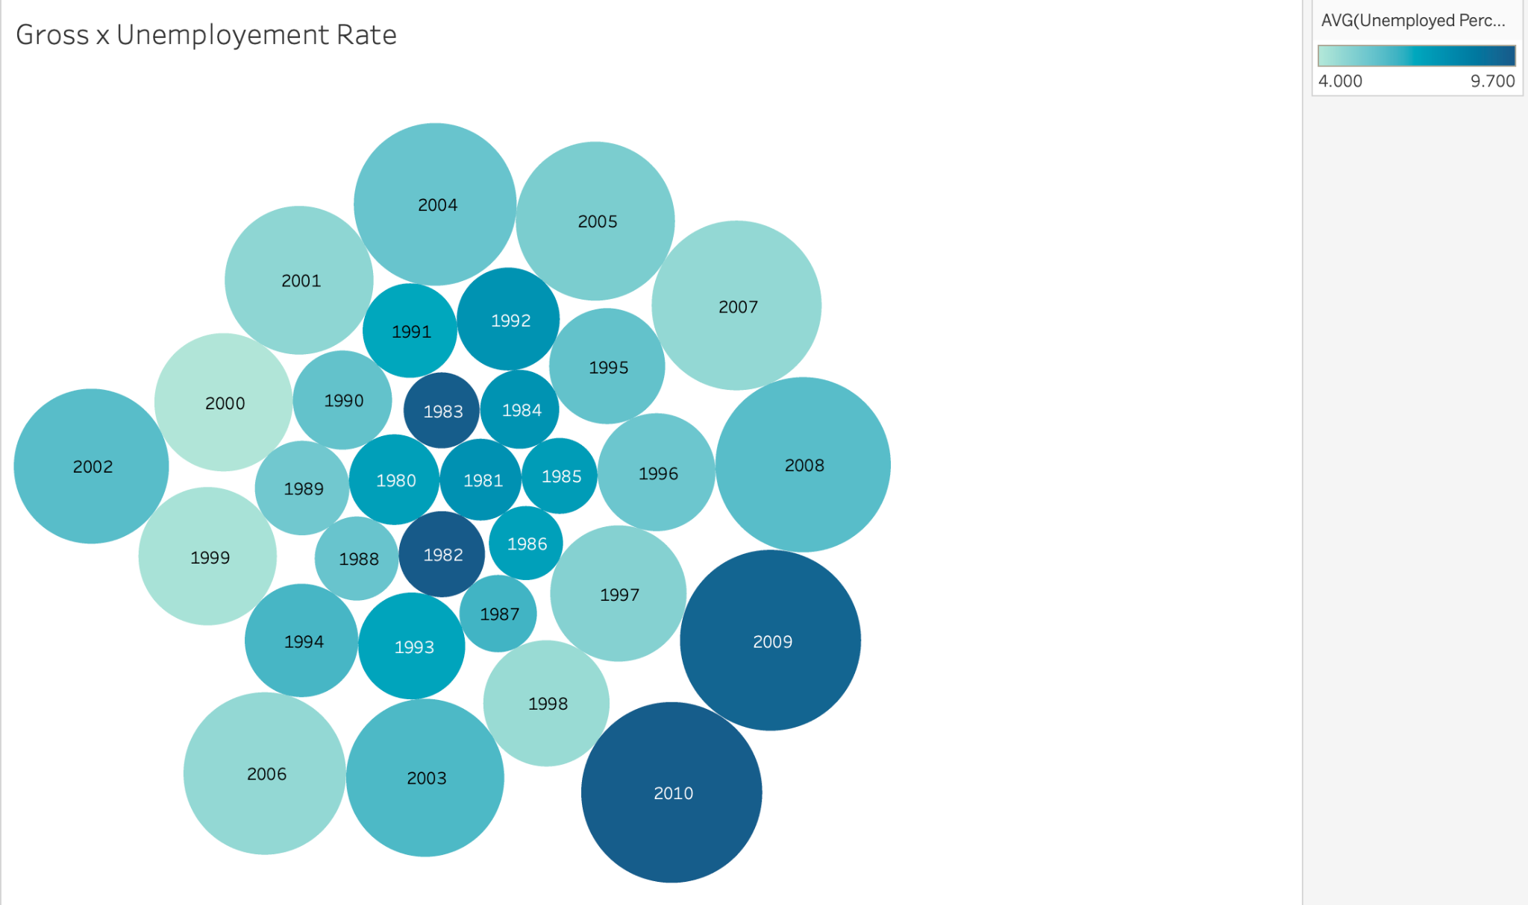
Unemployed_percent
The gross revenue grows every year, even in years with a relatively high unemployment rate.
The graph on the right shows several years of high gross revenue with a low unemployment rate, proving “unemployed percent” and “gross” are negatively related but weak.
Notes:
Jou ann

Slide 18
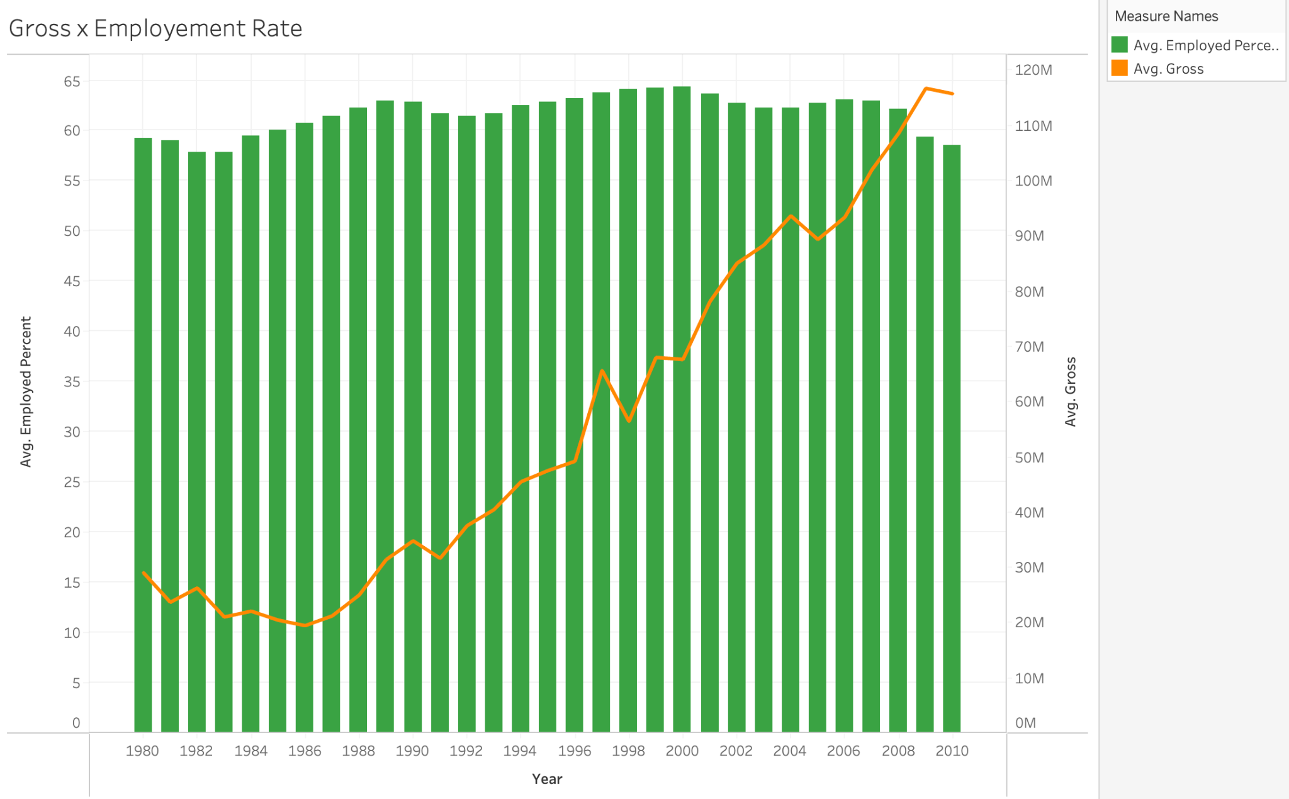
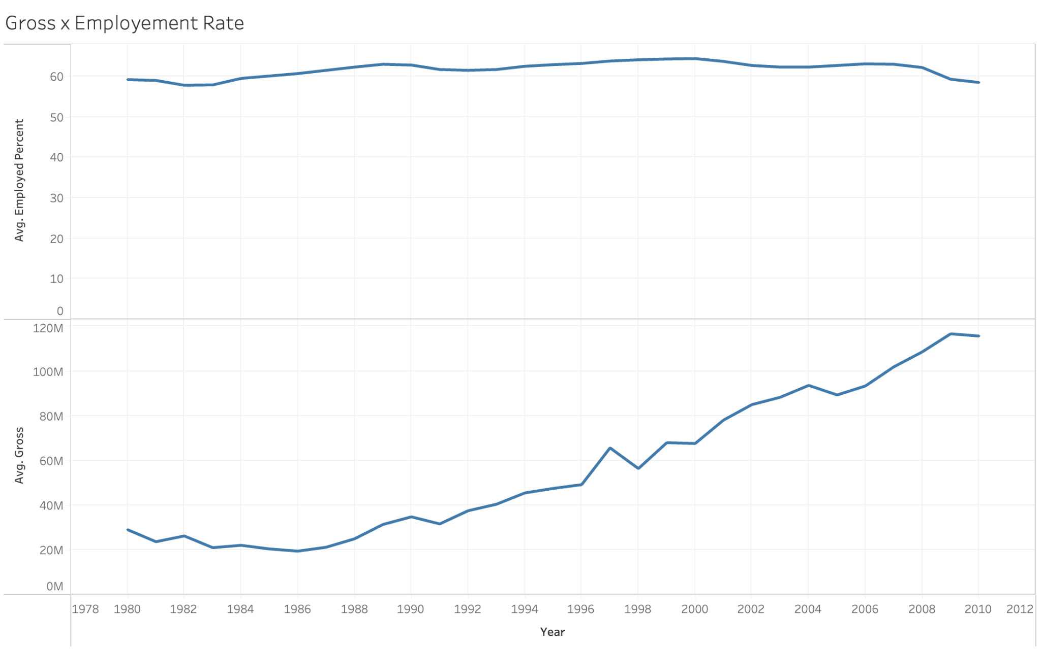
Employed_percent
The gross revenue grows every year, and the employment rate is steady.
The graphs show weak relationship between “employed_percent” and “gross”.
Notes:
Jou ann

Slide 19
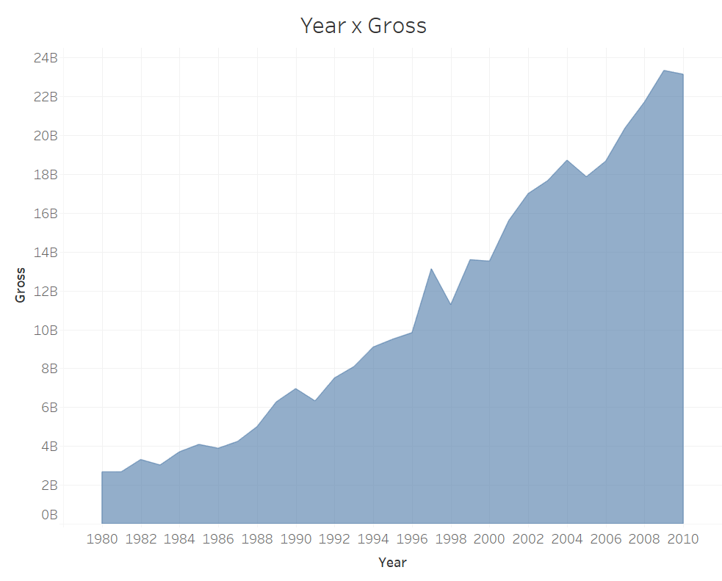
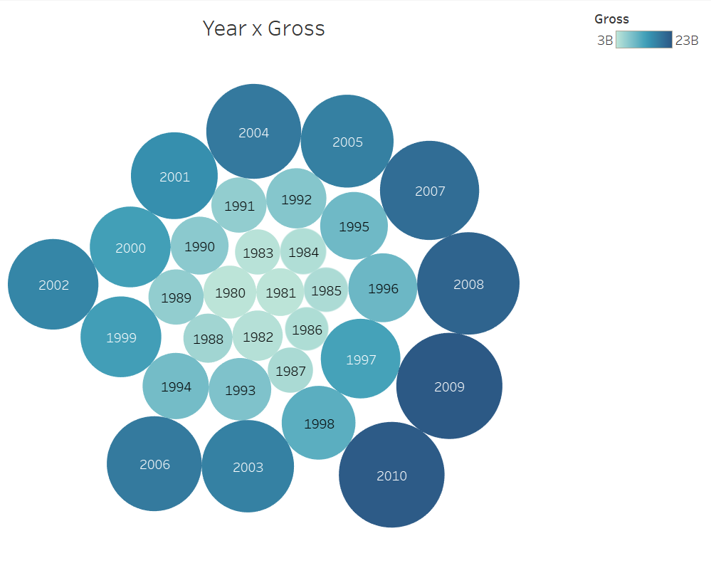
Year
Both graphs show that there is a positive relationship between Year and Gross Revenue. Gross Revenue keeps increasing as time goes by. Starting from 1996, there has been a drastic growth and gross revenue reached 23B in 2010, which is almost 12 times as much as 1980.
Notes:
Genre x year?
Is there a possibility that movie genre increases in recent years? → more genre, more revenue?

Slide 20
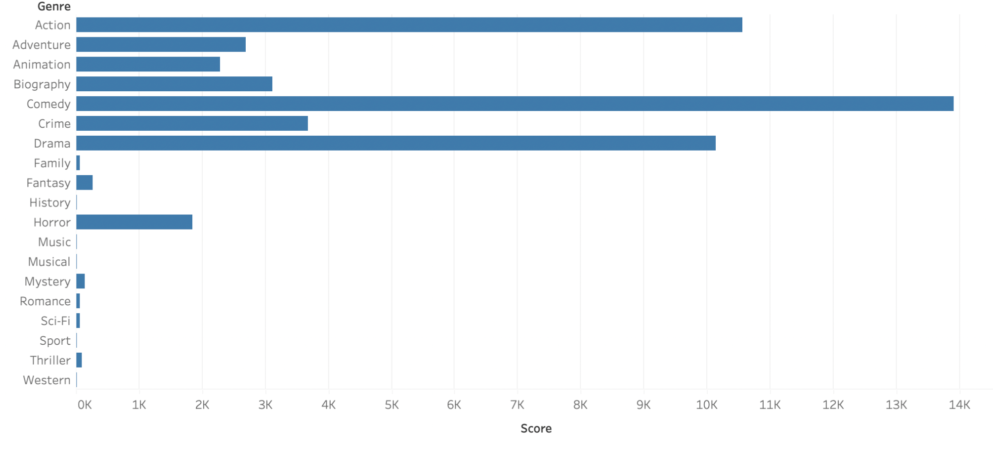
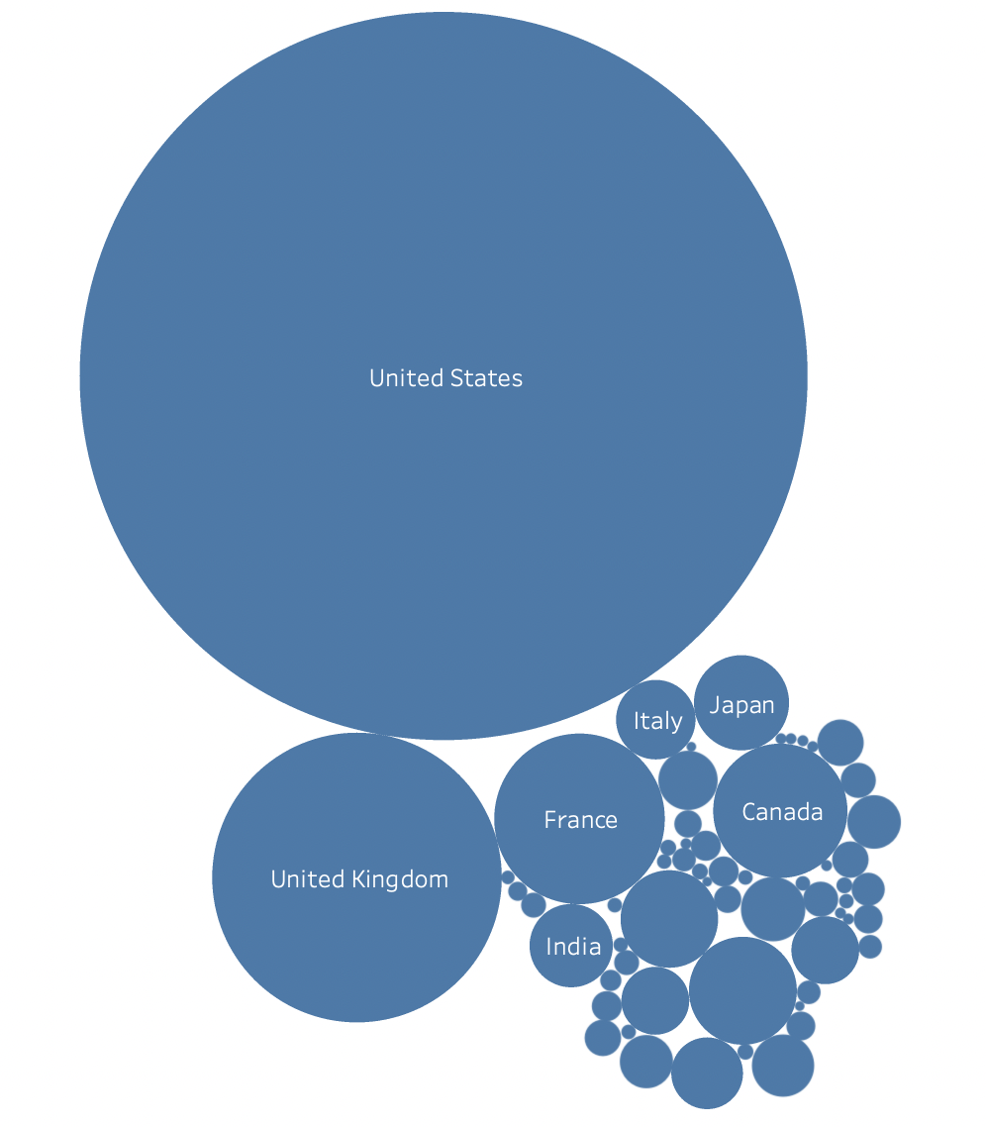
IMDB Score
IMDB Score x Genre
IMDB Score x Country
The results of these visualizations assume that IMDB score is related to the film’s genre and country of origin. To elaborate, comedy, action, and drama received higher IMDB scores whereas Western, Musical, and Historical centered films received incredibly low scores. Moreover, films based in the US received the highest average scores, with the UK and France following in 2nd and 3rd place.

Slide 21
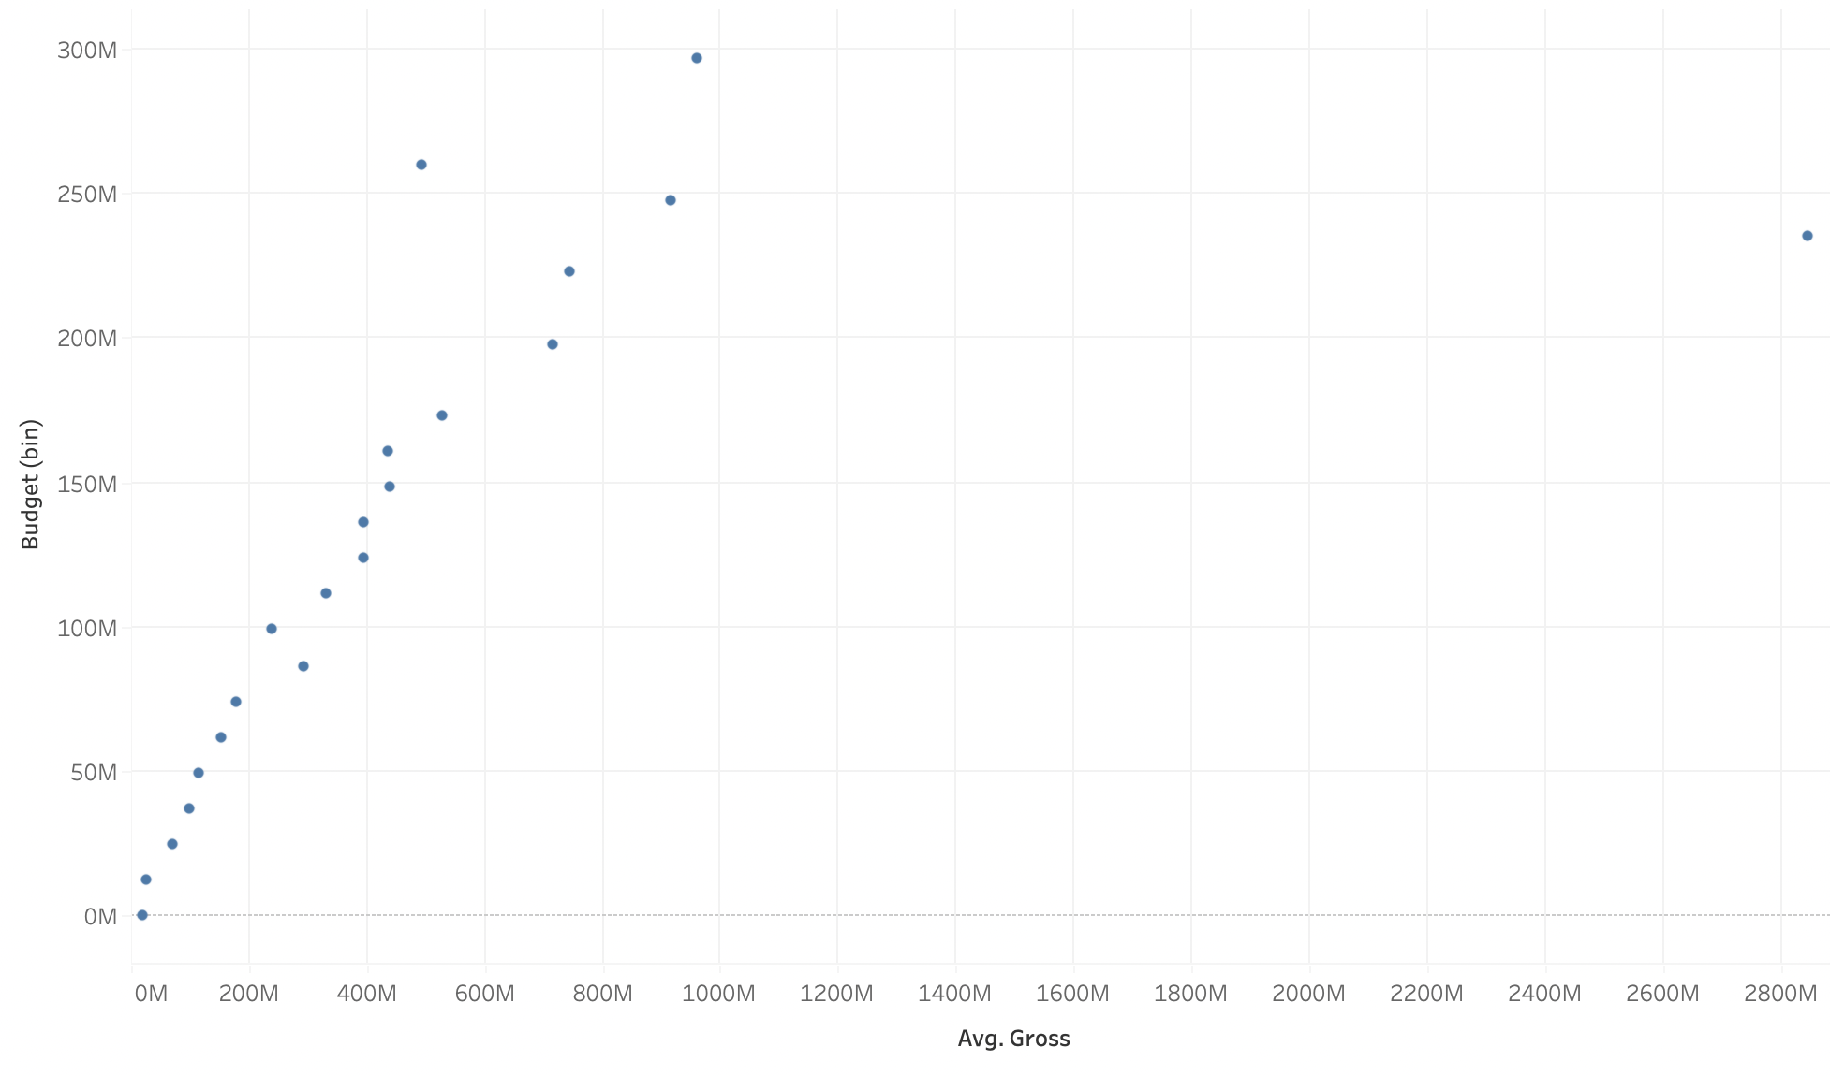
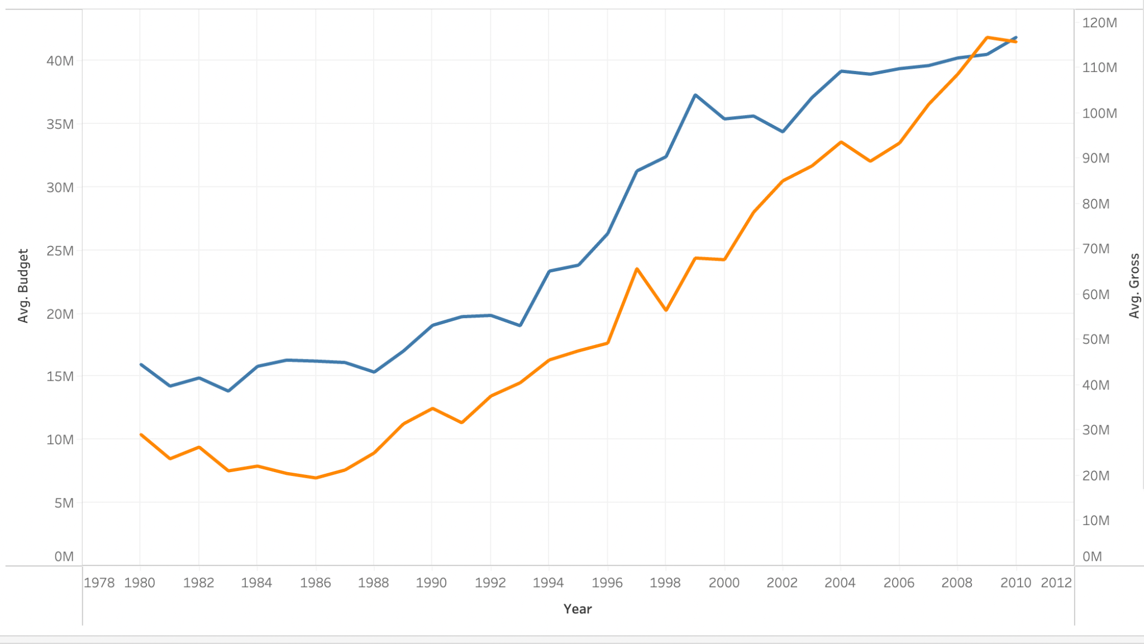
Budget
Budget and average gross revenue are directly related
Avg. Gross

Slide 22
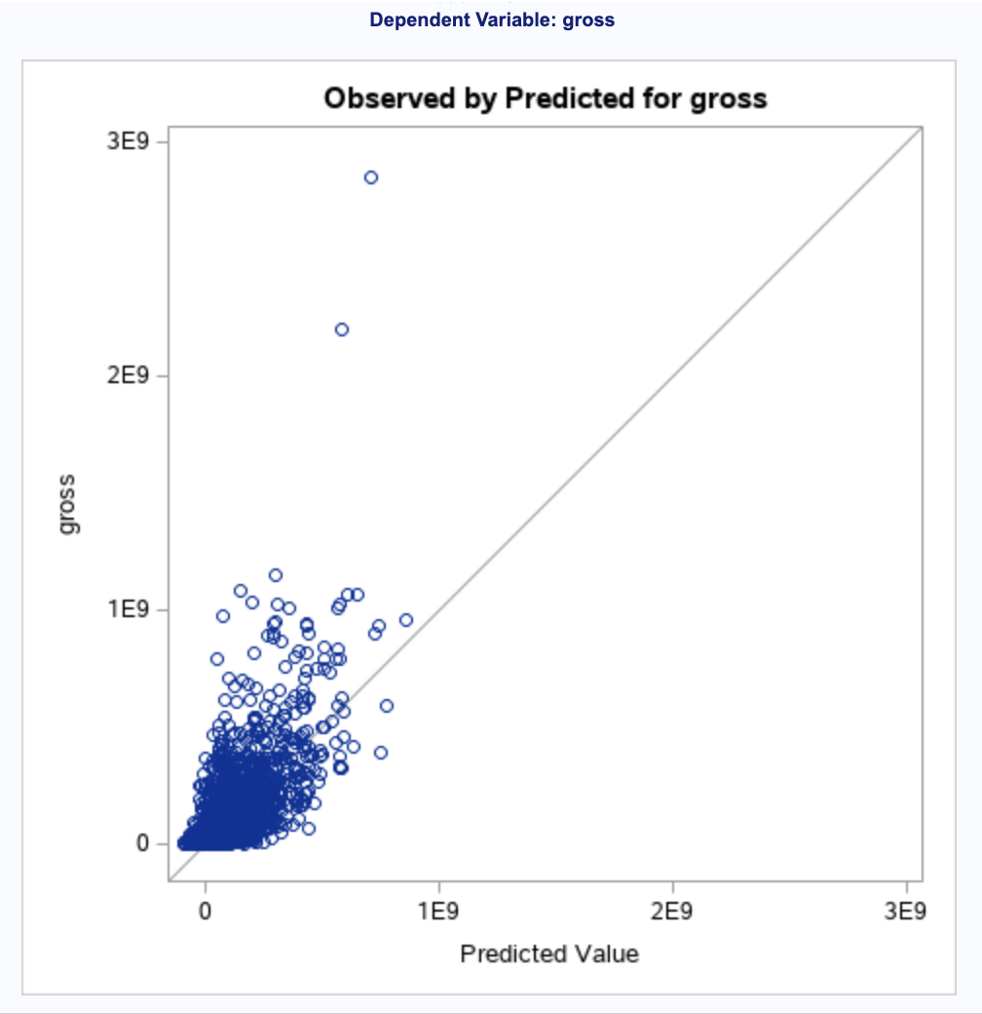
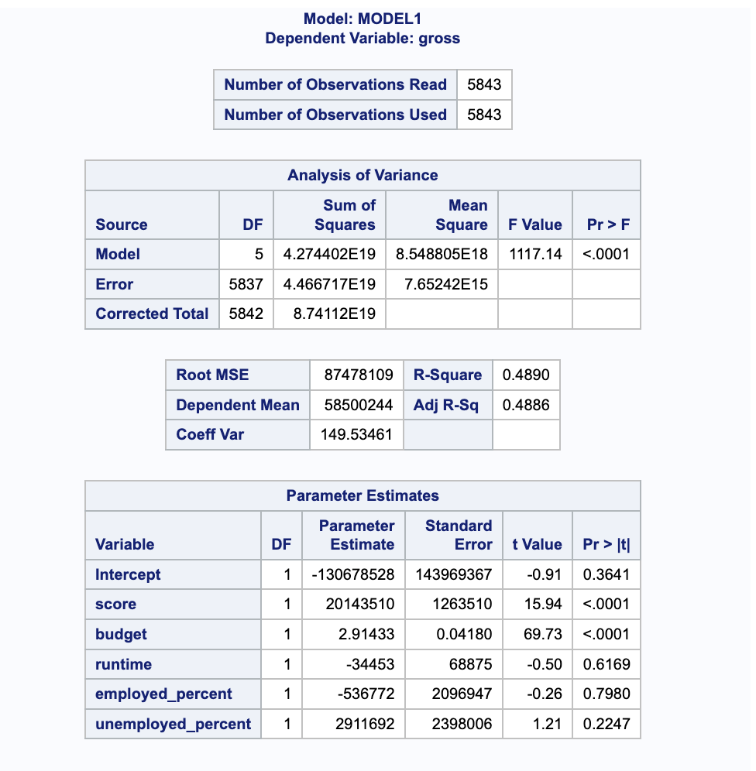
Multivariate Linear Regression Models
This graph shows we had a reasonably strong goodness of fit
Gross = 20143510*score + 2.91433*budget

Slide 23
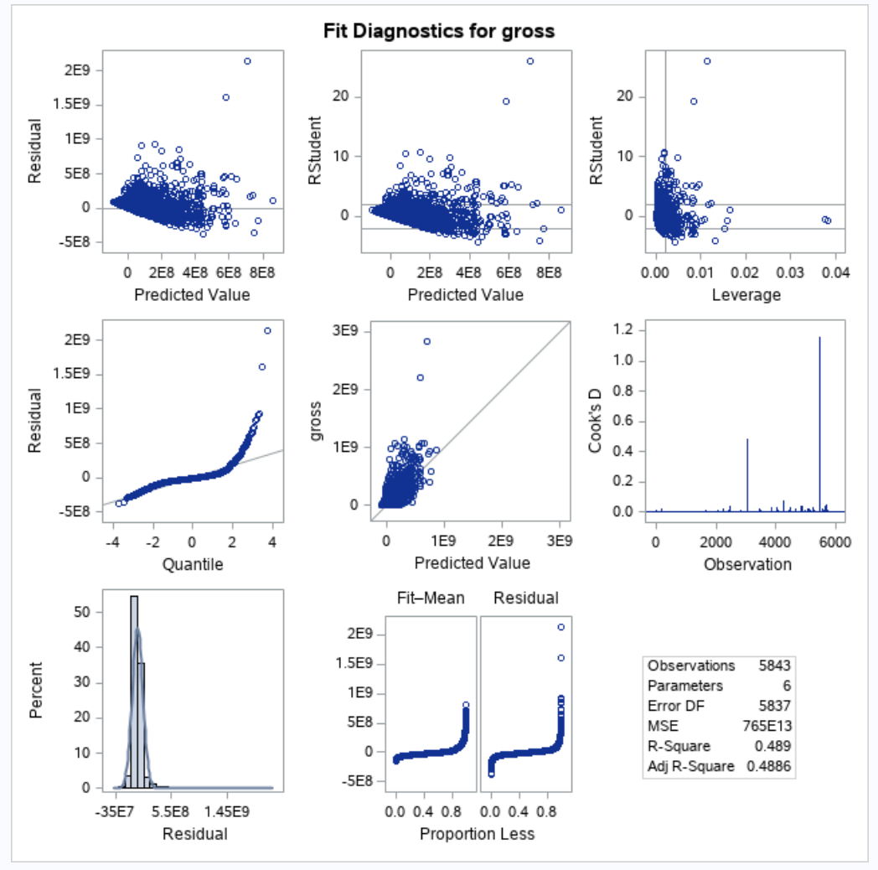
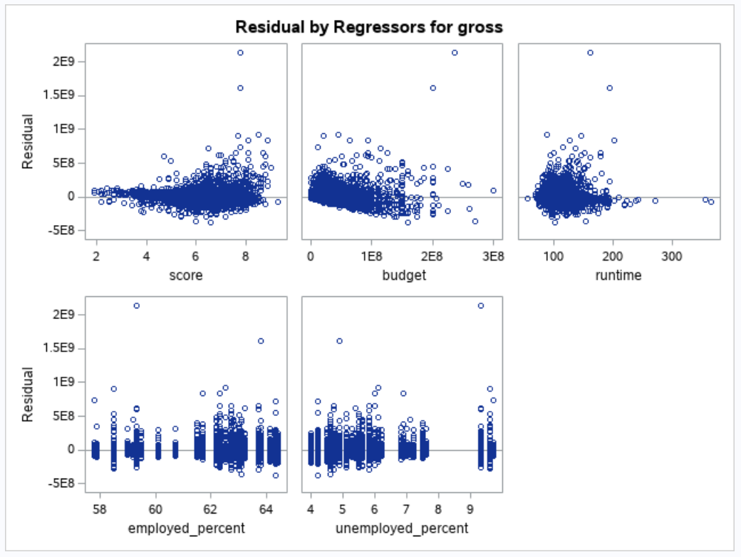

Slide 24
Linear Regression Conclusions
With a strong R-square of 0.489, almost half of our data can be explained by this linear regression model.
R-square is 48.9% which is higher than 30%, reflecting a goodness to fit
Residual Analysis - as most of our values are close to the diagonal line, our actual values are very close to predicted values.

Slide 25
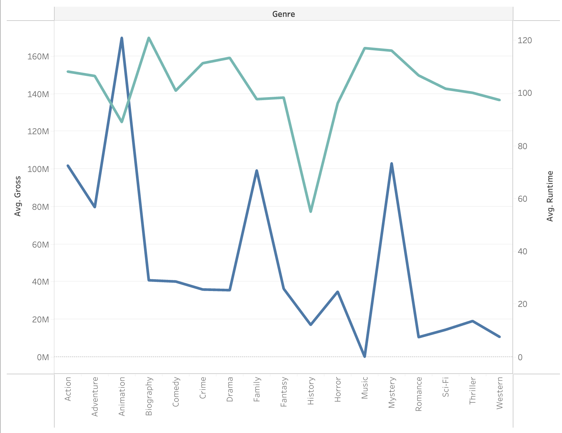
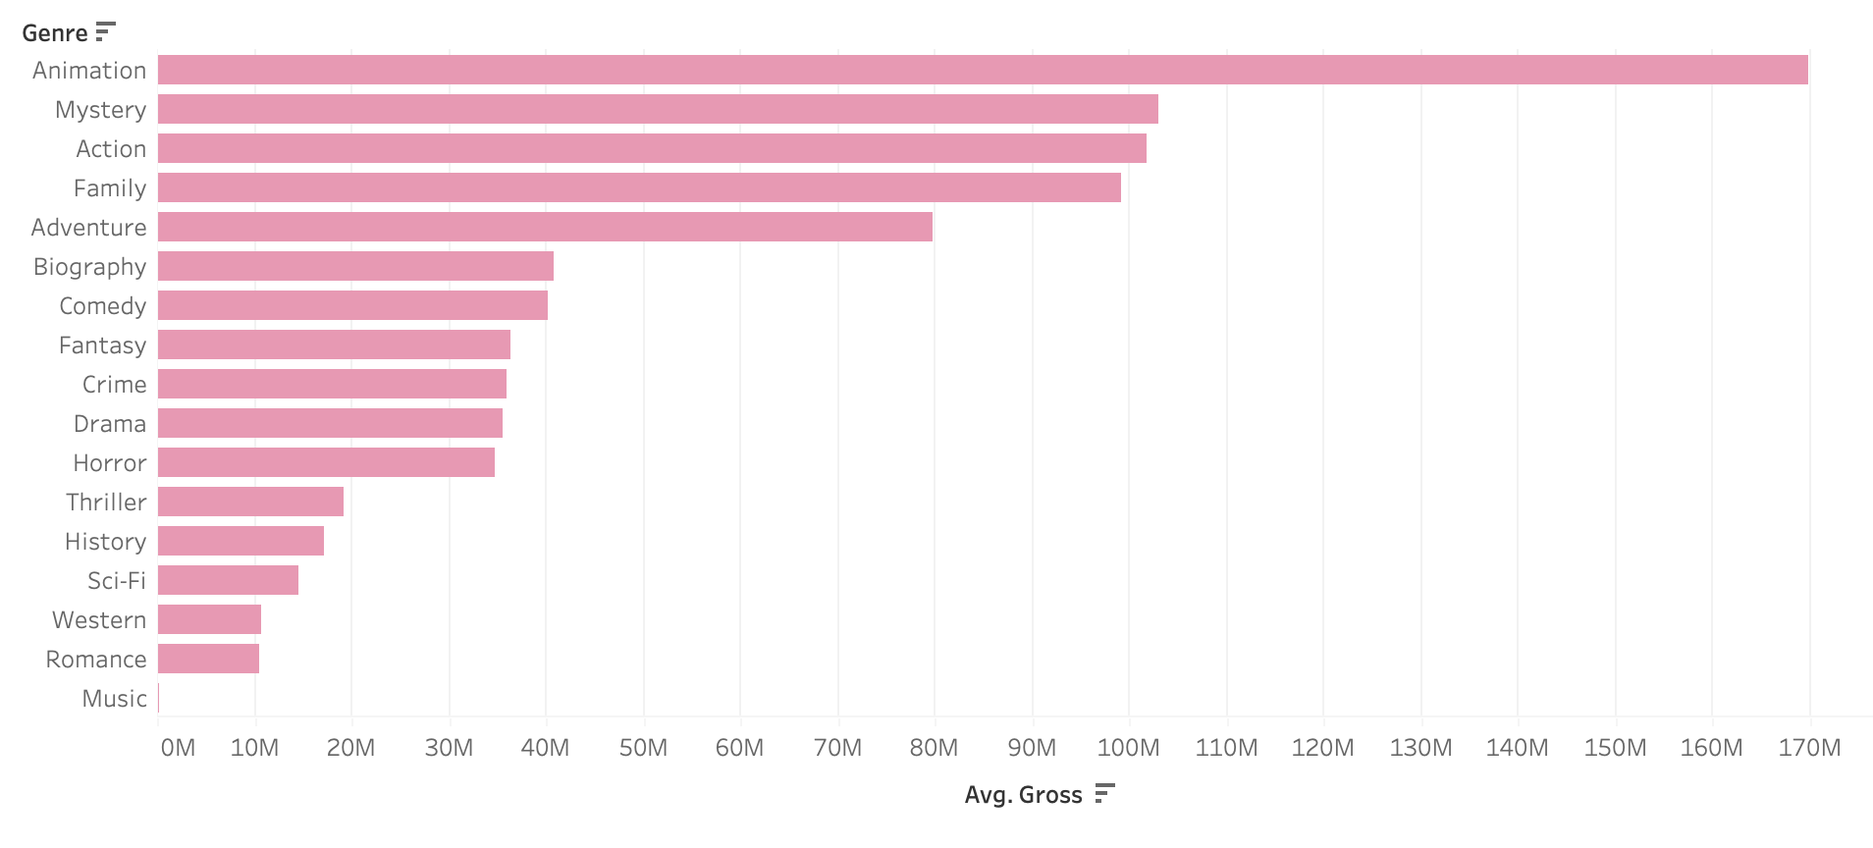
Genre
This chart shows us which genres had the highest (average) revenue, which includes Animation, Mystery and Action. The least earning genres include Music, Romance and Western.
This line chart demonstrates that there is a close relationship between (average) gross revenue and (average) runtime, in relation to genre. Aside a few anomalies such as Animation, genres with a longer average runtime had a higher average gross revenue.

Slide 26
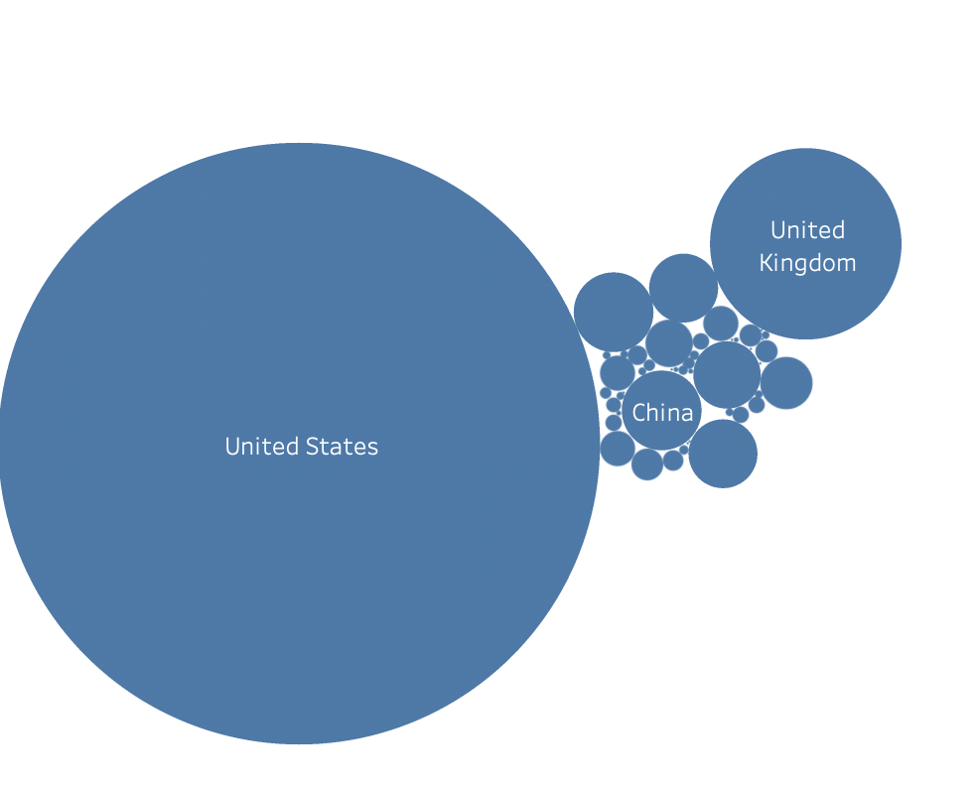
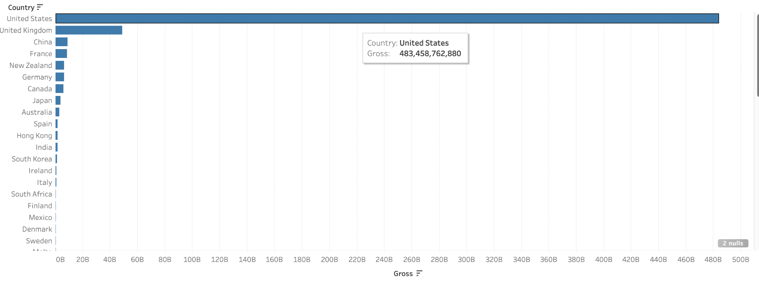
Country
Both graphs show the gross revenue by country, with the United States having the highest gross revenue by far with the UK falling far behind but still being significantly ahead of every country following (China in third, France in fourth)

Slide 27
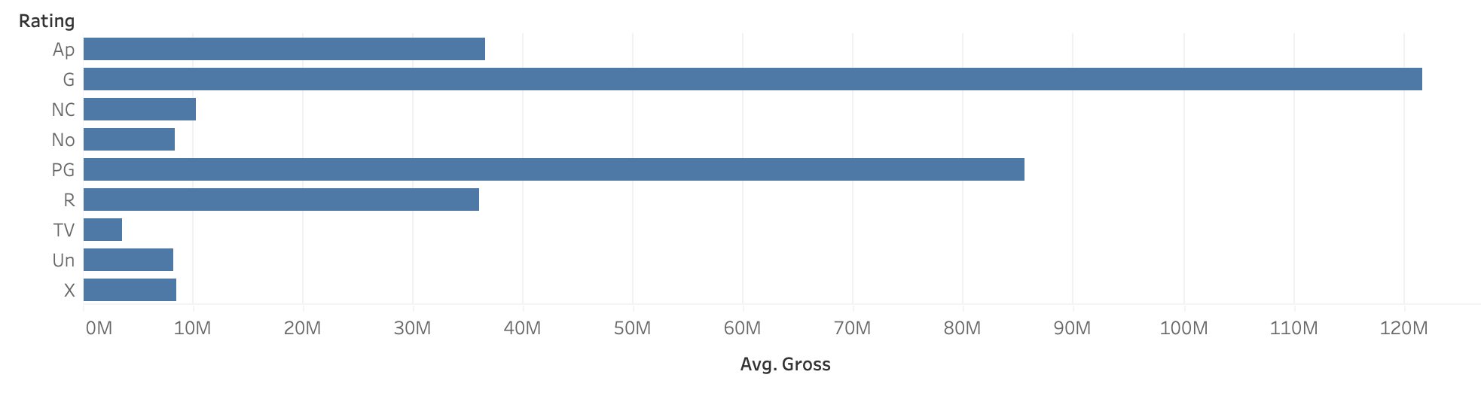
Rating
As shown in the graph, the top 3 maturity ratings in terms of gross revenue were G-rated, PG-rated and R-rated films. This is a logical conclusion, as G-rated movies are available to the widest audiences, PG-rated are the next most widely available, followed by R-rated movies.

Slide 28
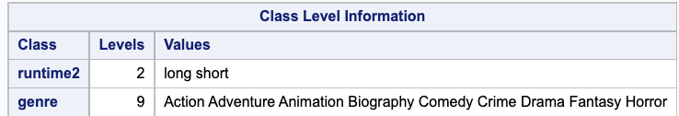
ANOVA
These were the variables we used - runtime and genre. There were 18 combinations we were able to analyze.
( The “runtime2” is the categorical variable converted by “runtime,” the independent numerical variable. If “runtime” <=90, “runtime2” = “short”. If “runtime” >90”, it’s “long.”)

Slide 29
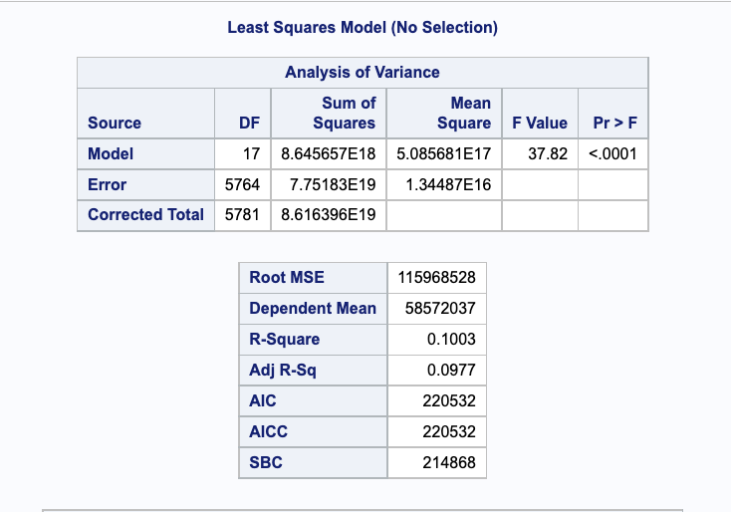
ANOVA
Overall, our ANOVA model is statistically significant with a p value <0.0001
We had a weak R-Square of 0.1003, which indicates our model explains only 10.03% of the total variance

Slide 30
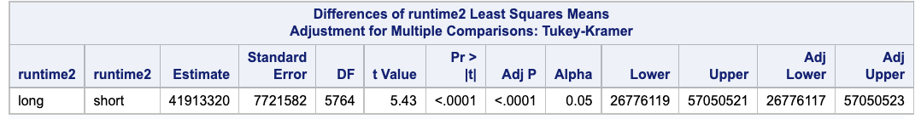
Statistically Significant Differences
This table shows that long movies (>90 minutes) make $41,913,320 more than short movies (90 minutes or less) in gross revenue.
These are the top 3 highest differences we found between genre categories. The table indicates that…
Animated films made $159,000,000 more than Drama movies in gross revenue.
Animated films made $158,000,000 more than Crime movies in gross revenue.
Animated films made $157,000,000 more than Biography movies in gross revenue.

Slide 31
Statistically Significant Interactions
These were the top 3 statistically significant interactions we found. The table indicates that…
Animated movies that lasted more than 90 minutes made $239,000,000 more in gross revenue than Biography movies that lasted 90 minutes or less.
Animated movies that lasted more than 90 minutes made $238,000,000 more in gross revenue than Drama movies that lasted 90 minutes or less.
Animated movies that lasted more than 90 minutes made $236,000,000 more in gross revenue than Crime movies that lasted 90 minutes or less.

Slide 32
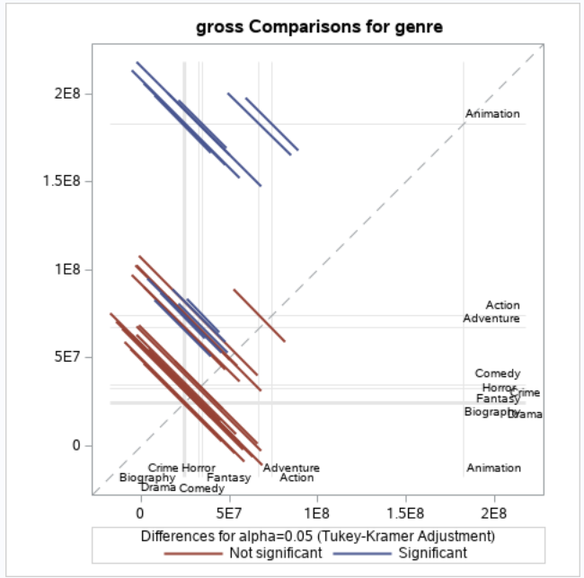
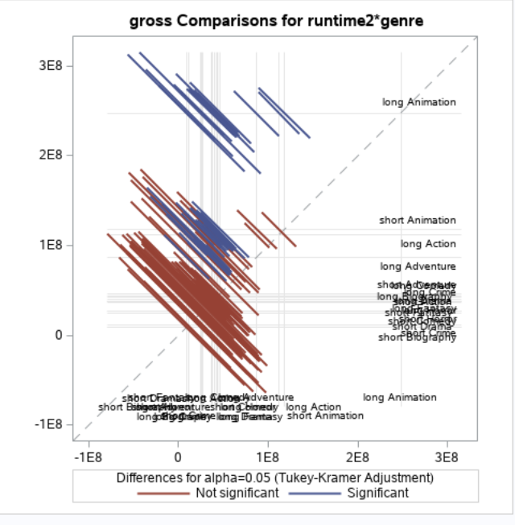
These charts illustrate that the majority of differences and interactions were not significant

Slide 33
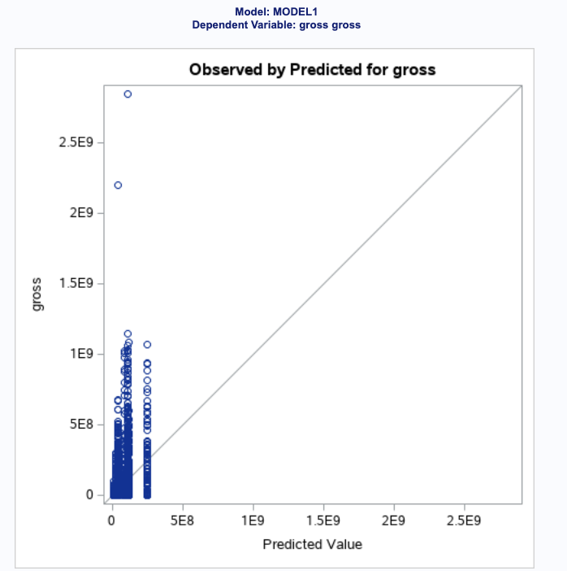
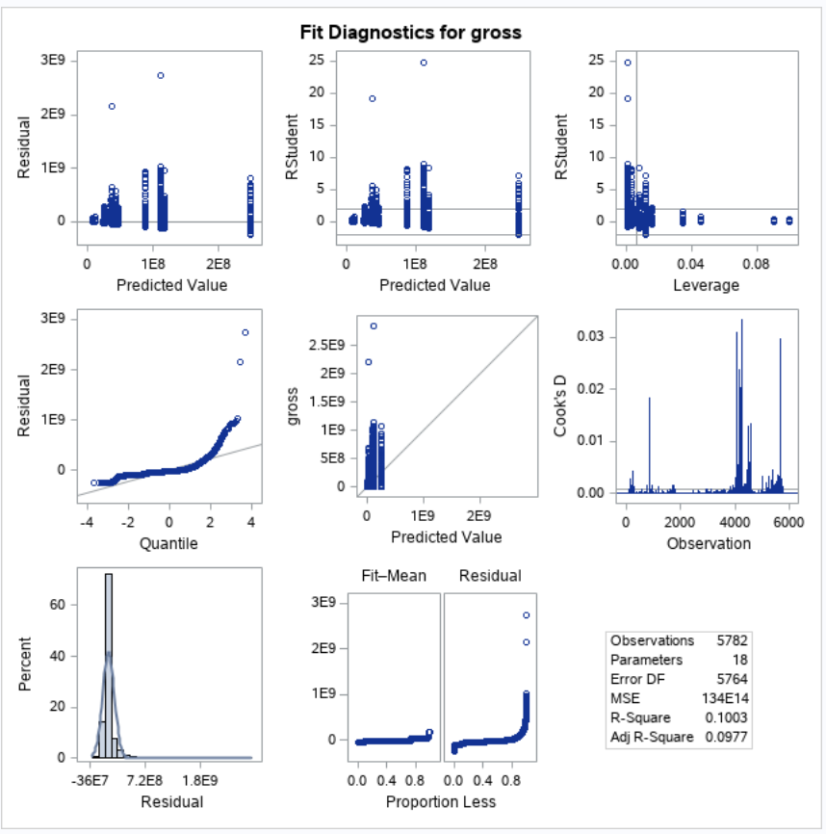
The graph on the left visualizes our weak R-Square. Although some observations on close to the line, most are not on it which indicates that our model has weak accuracy.

Slide 34
Conclusion
The correlations show that all of the independent numerical variables are related to the dependent variable, gross revenue.
However, after further doing Linear Regression models, we found that only “score” and “budget” can be used to predict “gross.” It’s a high-valued model which can explain almost half of our data.
The result of ANOVA indicates long movies (movies that last longer than 90 minutes) make higher revenue, and people also prefer watching animation movies over other genres. Thus, long animation movies are the most profitable. However, this result can only explain 10% of the data according to the weak R square.

Slide 35
Project 2 Appendix: Phase 1 & 2

Slide 36
Phase 1 - Business Goal
Our business goal is to analyze the relationship between gross revenue and several other factors such as yearly unemployment rate, rating, genre, year, country, and more.

Slide 37
Phase 1 - Variables
Dependent Variable: Gross Revenue
Independent Variables: Budget, Runtime, Unemployment Rate, Employment Rate, IMDB Score, Year, Genre, Country, Movie Rating
Numeric Variables: Gross Revenue, Budget, Runtime, Unemployment Rate, Employment Rate, IMDB Score
Categorical Variables: Year, Genre, Country, Movie Rating
Calculated Variables: Unemployment Rate, Employment Rate

Slide 38
Phase 1 - Data Collection
Data Source 1: Movie Industry Analysis - access data set
Data Source 2: US Employment & Unemployment Rate since 1940 - access data set

Slide 39
Phase 1 Summary
Goal Definition
Business Goal: Our business goal is to analyze the relationship between gross revenue and several other factors such as yearly unemployment rate, rating, genre, year, country, and more.
Dependent Variables: Gross Revenue (numeric variable)
Independent Variables:
Numerical Variables: Budget, Runtime, Unemployment Rate, Employment Rate, IMDB Score
Categorical Variables: Year, Genre, Country, Movie Rating
Calculated Variables: Unemployment Rate, Employment Rate
Data Collection
Data Source 1: Movie Industry Analysis - access data set
Data Source 2: US Employment & Unemployment Rate since 1940 - access data set
Notes:
amanda

Slide 40
Phase 2
Data Collection
Number of Observations:
File 1 (Movie Data): 7,668 rows
File 2 (Employment Data): 71 rows
Files: 2 files, inner join (common variable: year of movie release)
Joined File
Dependent variable: 1 (gross revenue)
Independent variables: 10
5,843 rows
Notes:
amanda

Slide 41
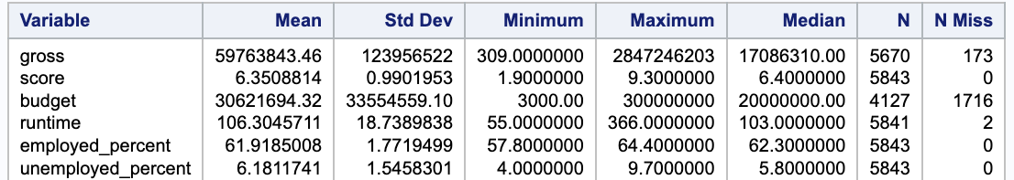
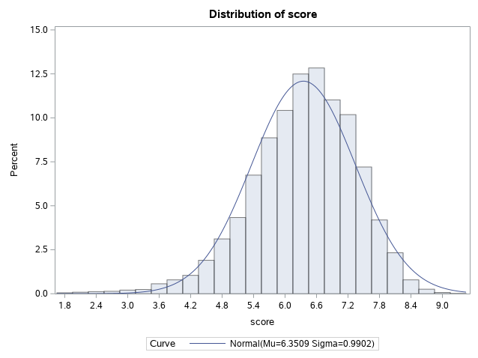
Phase 2 - Descriptive Statistics
The mean and median of score are close to each other, which indicates that the data set has a symmetrical distribution (as confirmed by the normal distribution graph on the right)
Notes:
Jou ann

Slide 42
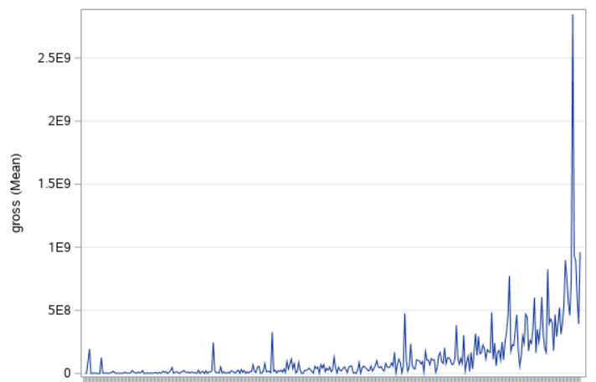
Phase 2 - Gross Revenue x Budget
Revenue increases with budget (direct relationship)
More money spent leads to more money made, with some outliers
Budget
Notes:
kayla

Slide 43
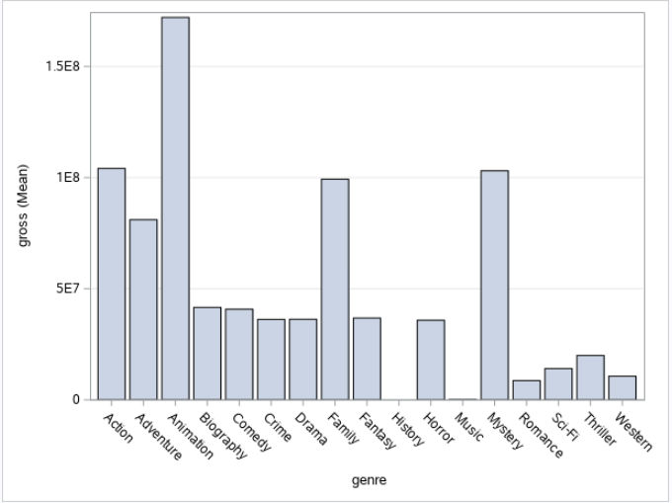
Phase 2 - Gross Revenue x Genre
Animation is the genre with the highest mean gross revenue
Mystery, action, and family movies were the next highest mean revenue
Overall family and children movies averaged highest mean gross revenue, niche genres averaged lower
Notes:
joshsh

Slide 44
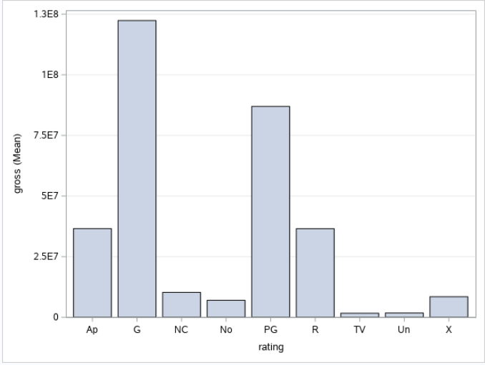
Phase 2 - Gross Revenue x Rating
Rating with the highest mean gross revenue: G, followed by PG
Lower age ratings have higher mean gross revenues
Possible explanation: larger target market in movies with more open age ranges
Notes:
mandy

Slide 45
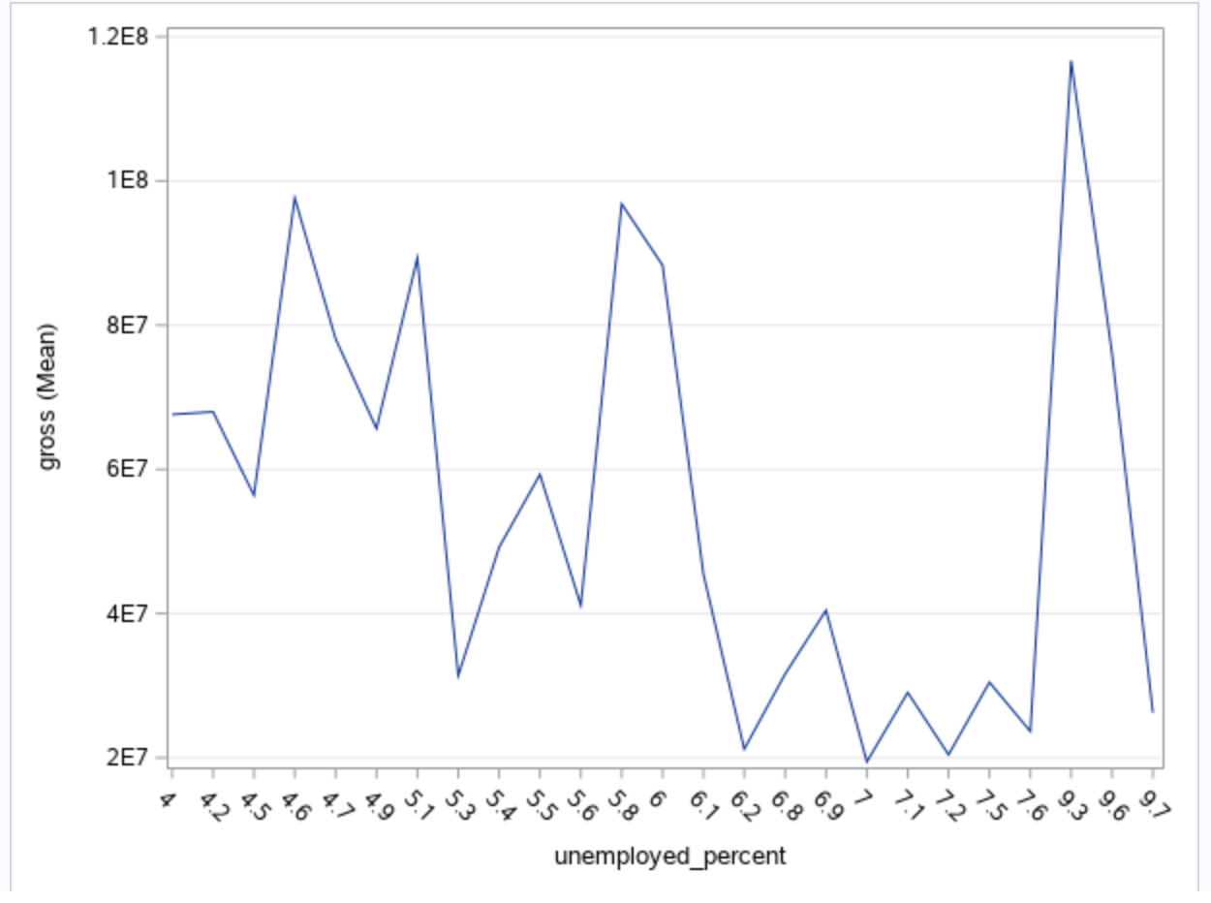
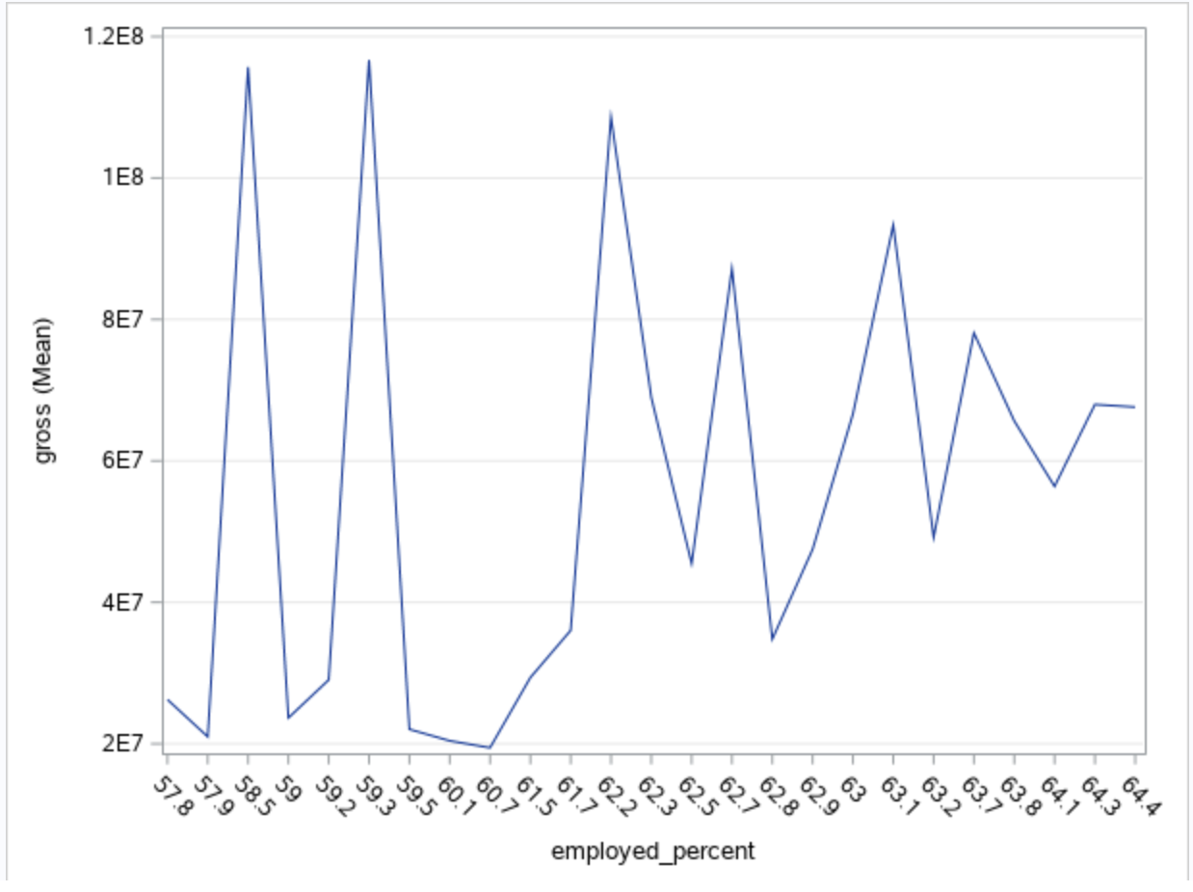
Phase 2
Notes:
brynne

Slide 46
Phase 2 - Interpretation, Action, and Feedback
Factors Impacting Gross Revenue - Conclusions
More family-friendly movies had higher mean gross revenue compared to niche genres and movies with limited age ranges (18+ or parental accompaniment required)
Positive correlation between employment rate and mean gross revenue suggesting better economics conditions lead to more revenue success for films
Notes:
meg

Slide 47
Phase 2 - Interpretation, Action, and Feedback
Recommendations / Decisions Available
Filmmakers can increase mean gross revenue by targeting larger audience ranges
Choosing genres that appeal more to family-friendly audiences (action, animation, family movies) can increase revenue
Release films under better economic conditions (higher employment rate) to increase revenue
There is a direct correlation between budget and gross revenue - filmmakers need to invest more to increase their gross revenue (assuming the movie is successful)
Notes:
selena

Slide 48
Phase 2 - Missing Data
From the original data sets, we deleted the variables (cleaned the data) that were not relevant to our business goal or analysis (director, star of the movie, etc.)
Notes:
selena

